Slide 1

AI and Machine Learning for IoT Big Data

Slide 2
Dissecting Deep Learning

Slide 3
Outline of the lecture
A very successful and important AI technique is Deep Learning. Here we will learn about its foundations and review an example for using it.
By understanding the current state of art, we will be ready to keep up with its ongoing evolution.
To benefit from this lecture, it is essential to work through the example in the accompanying notebook.

Slide 4
Where are we in the Course?
Introduction: Background of IoT, Big Data, AI
Collect, analyze data from IoT on a large scale
Elements and practice of statistics
AI methods for data science
Getting further with AI: internal workings
Practical usage of AI for Big Data from IoT
Moving into the real world

Slide 5
Lecture 6: Dissecting Deep Learning
Review of Deep Learning
Example: Plant Disease Detection
Images as input
Network structure
Activations
Transfer learning
Results, discussion

Slide 6
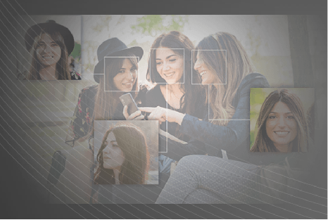
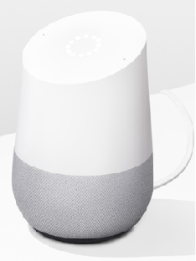
AI Success Stories
Machine Vision Surveillance Photo analysis Identification …
Speech Recognition Assistant Controller …
https://www.sensetime.com/intelligentVideo/83
https://store.google.com/product/google_home
Notes:
Mention many alternatives, extremely competitive field
Machine vision: Google, Facebook etc.
Speech recognition: Apple Siri, Amazon Alexa, etc.

Slide 7
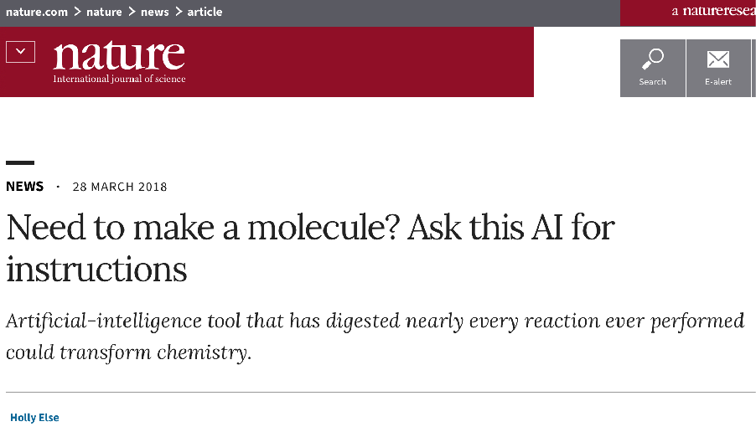
Recent example: discovery of chemical synthesis rules
https://www.nature.com/articles/d41586-018-03977-w?error=cookies_not_supported&code=75546f74-67b1-4d92-8301-5aebf96df3f3
Notes:
Discussion: how can AI assist in creative tasks?

Slide 8
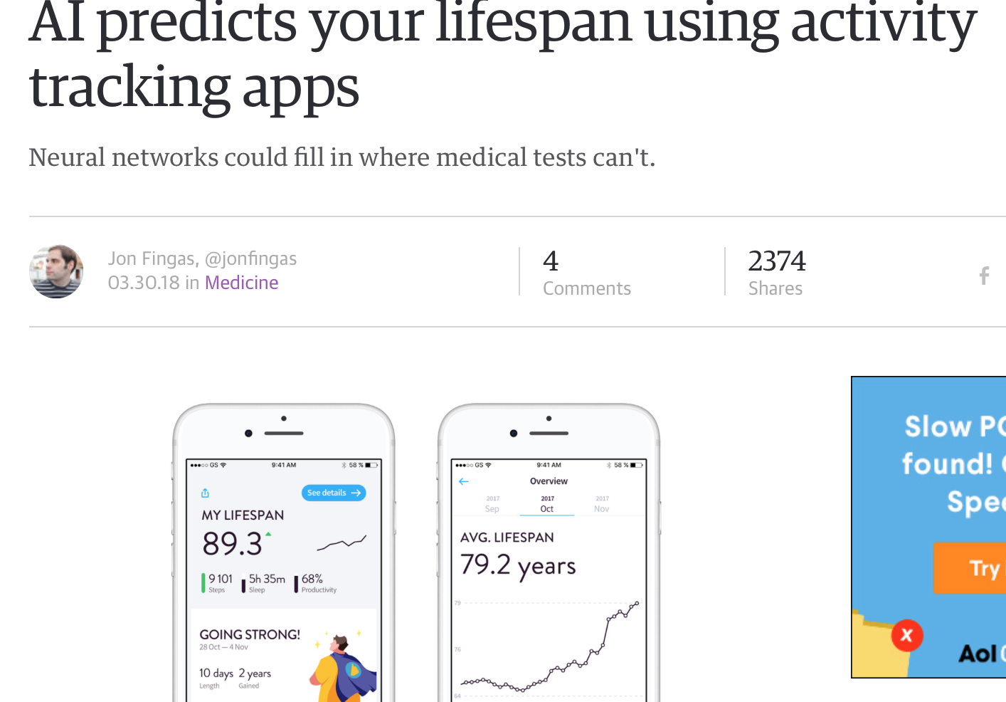
Recent example: app for predicting lifespan
https://www.engadget.com/2018/03/30/ai-predicts-your-lifespan-using-activity-tracking-apps/
Notes:
Discussion: how can AI be incorporated into daily life?

Slide 9
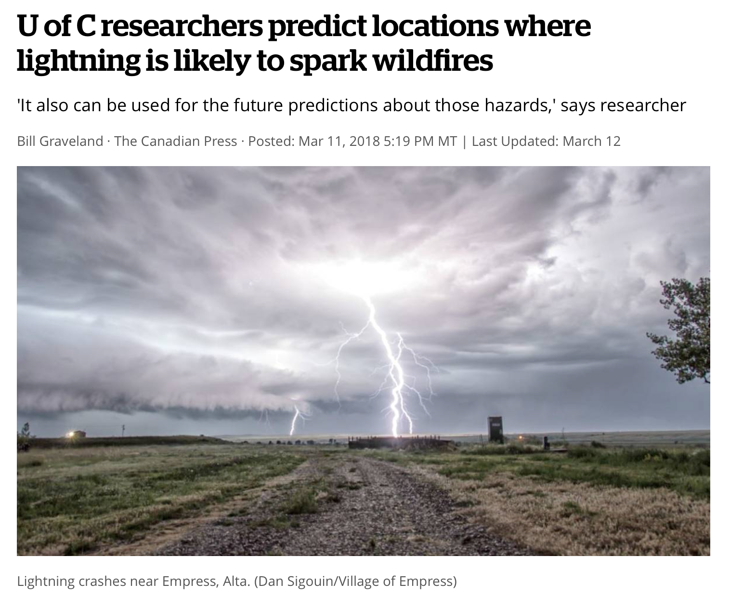
Recent example: predicting lightning strikes
http://www.cbc.ca/news/canada/calgary/lightning-wildfires-study-1.4571912
Notes:
Discussion: how can AI be used for safety, security?

Slide 10
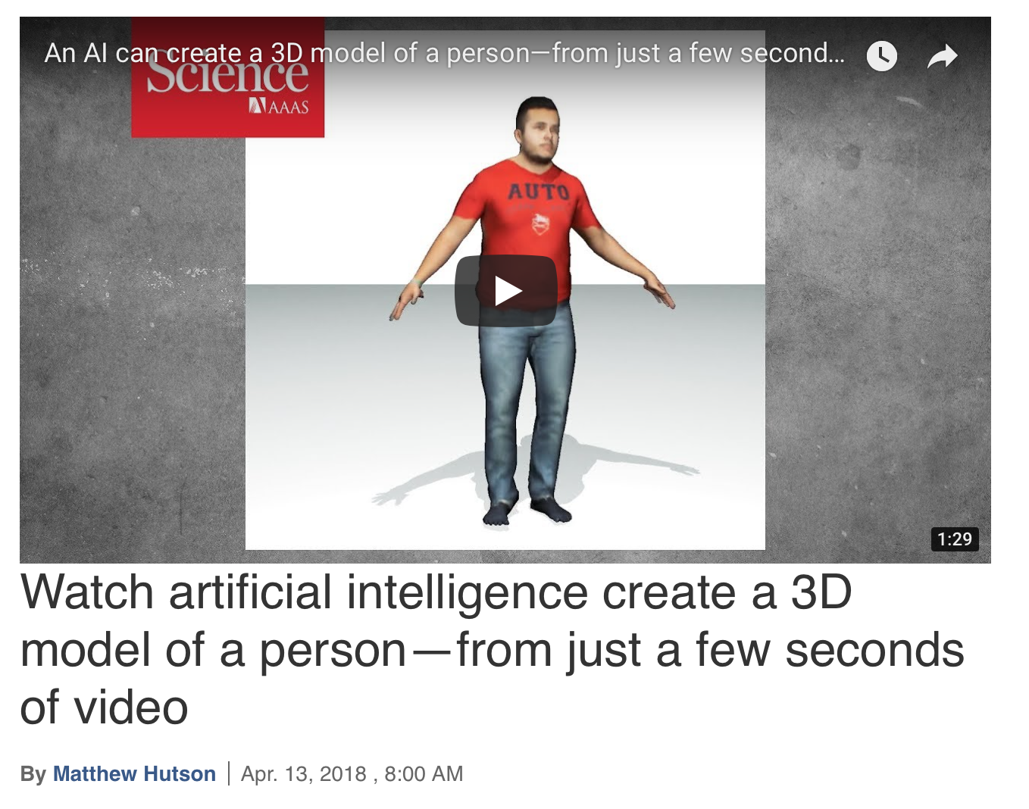
Recent example: creating 3D models from video
http://www.sciencemag.org/news/2018/04/watch-artificial-intelligence-create-3d-model-person-just-few-seconds-video
Notes:
Discussion: how can AI be used in computing tools?

Slide 11
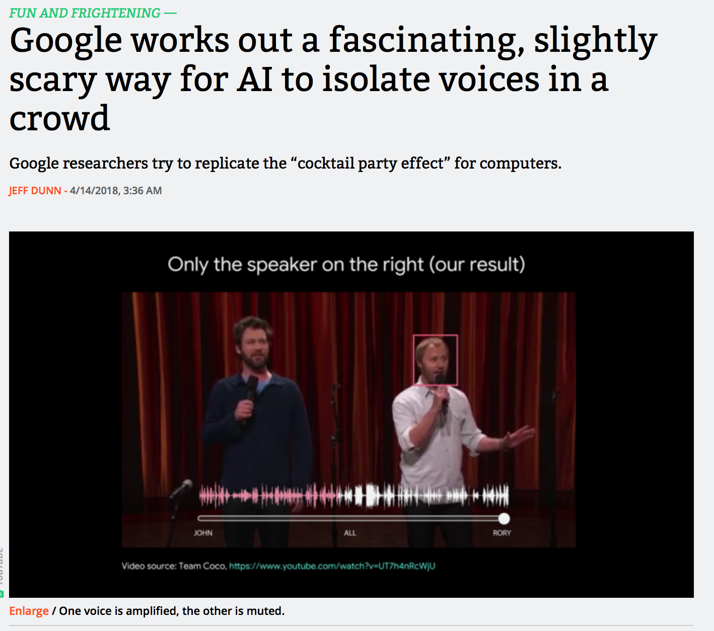
Recent example: AI for cocktail-party effect
https://arstechnica.com/gadgets/2018/04/google-works-out-a-fascinating-slightly-scary-way-for-ai-to-isolate-voices-in-a-crowd/
Notes:
Discussion: how can AI be used as components, e.g. in hearing aids?

Slide 12
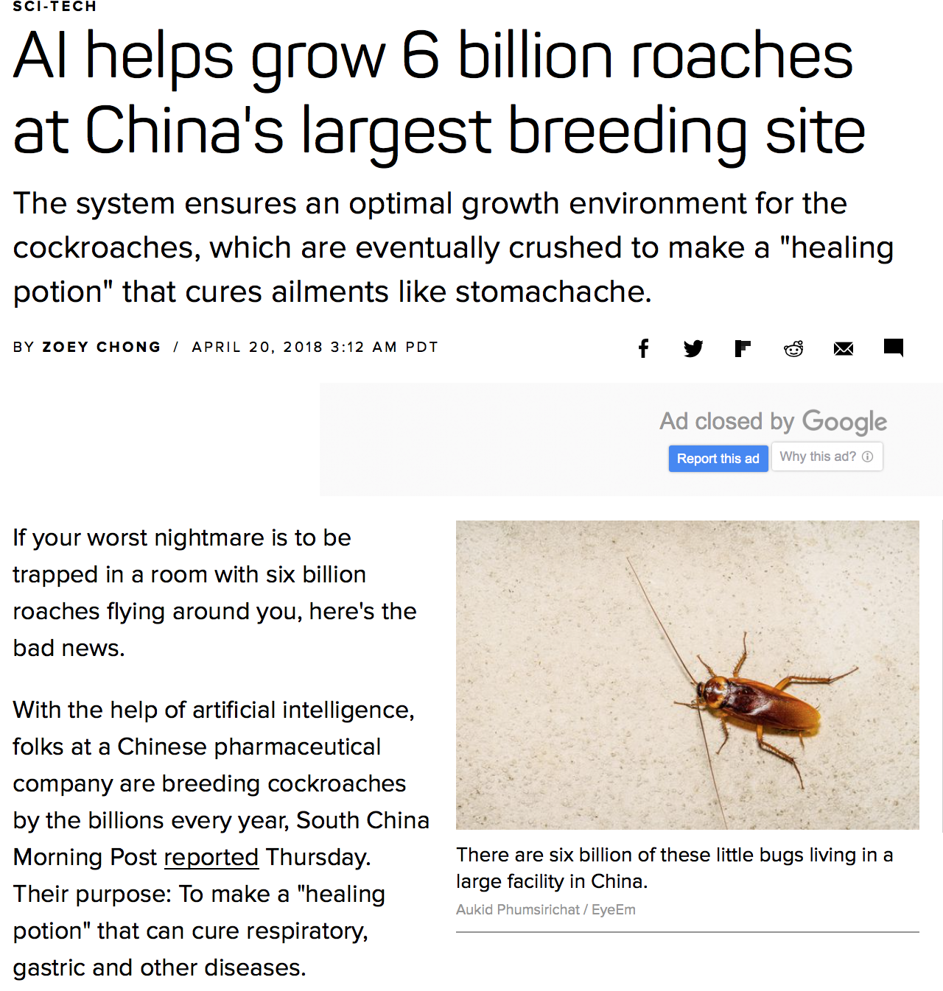
Recent example: helping insect farming
https://www.cnet.com/news/ai-helps-grow-6b-roaches-at-chinas-largest-breeding-facility/
Notes:
Discussion: how can AI assist in biological and agricultural industries?

Slide 13
What is (“shallow”) Learning?
We create “features” from the input data: for instance, “formants” for speech, “texture” for images, … (based on domain knowledge)
Learning modifies all layers
Use one or a few “hidden” layers
Learning can be done with relatively little data
Learning is fairly quick
Notes:
A lot of research have been done in the past to design and refine feature generation
Neural Networks have been used for decades; the biggest change is the abundance of processing power

Slide 14
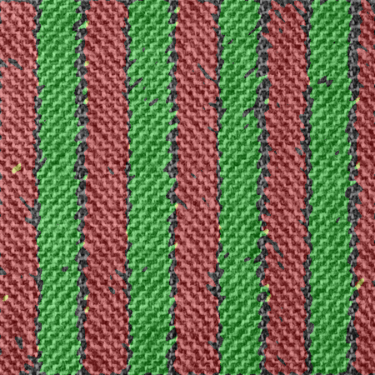
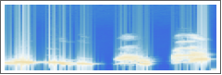
Some feature extraction methods
Images: - texture statistics - contours
Voice: - spectrum (FFT) - cepstrum - formant structure
Wolfram Research, Inc., Mathematica, Version 11.3, Champaign, IL (2018).
Notes:
Textures: mention Haralick features https://ieeexplore.ieee.org/document/4309314/
Spectrum: mention FFT in Scipy, Numpy

Slide 15
What is Deep Learning?
Features are learned, not extracted by human-made algorithms
Learning proceeds by layers, creating feature-generating structure for the input
Use a lot of layers
Use a lot of data
Learning is computationally intensive
Notes:
Point out the similarity with sensory information processing in the brain
(see also later slide)

Slide 16
The Turning Point: Deep Learning
A View from Emerging Technology from the arXiv
The Revolutionary Technique That Quietly Changed Machine Vision Forever
Machines are now almost as good as humans at object recognition, and the turning point occurred in 2012, say computer scientists.
September 9, 2014
https://www.technologyreview.com/s/530561/the-revolutionary-technique-that-quietly-changed-machine-vision-forever/
Notes:
Sudden breakthroughs occur almost at the same time in vision, speech recognition, text analysis etc.
Real-time image recognition is reaching human performance levels.
Google’s or Amazon’s speech recognition engines are finally practically useful and used daily.

Slide 17
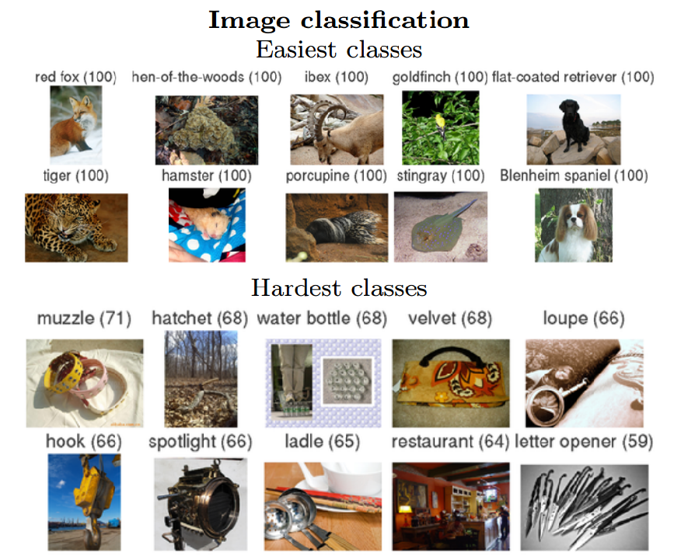
ImageNet Large-Scale Visual Recognition Challenge
… all that changed in 2012 when a team from the University of Toronto in Canada entered an algorithm called SuperVision, which swept the floor with the opposition.
https://www.technologyreview.com/s/530561/the-revolutionary-technique-that-quietly-changed-machine-vision-forever/
Notes:
a technique called deep convolutional neural networks which the Super Visison algorithm used to classify the 1.2 million high resolution images in the dataset into 1000 different classes.

Slide 18
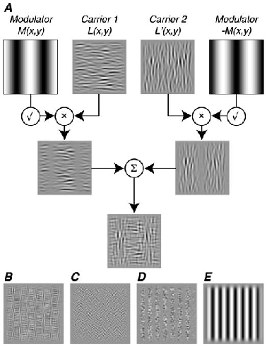
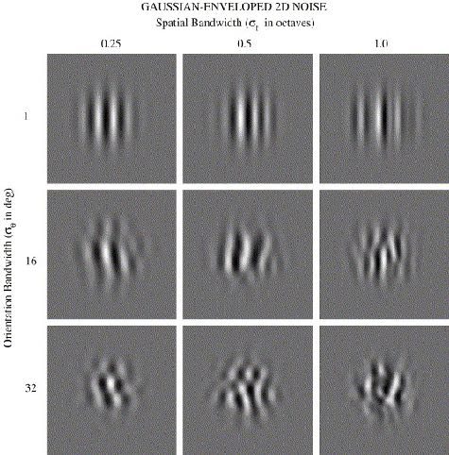
Background: neuro-physiological research in humans and primates
Development of sensitivity to visual texture modulation in macaque monkeys
Yasmine El-Shamayleh, J. Anthony Movshon, and Lynne Kiorpes
Orientation discrimination in human vision: Psychophysics and modeling
Author links open overlay panel
William H.A.BeaudotabKathy T.Mullena
Neural circuits extract “generally useful” information from the visual signal; these will be combined gradually into higher-order features, eventually allowing object recognition and other high-level visual tasks.
Notes:
Psychological and physiological experiments established the initial processing model for vision.
Researchers found neurons responding selectively to specific spatial frequencies, specific
orientations, specific texture patterns etc. These neurons are replicated across the visual field.
This gave the hint to LeCun, Hinton, and others, to develop a similarly structured neural network
model: the Convolutional Neural Network.

Slide 19
ImageNet and its followers
Convolutional neural networks consist of several layers of small neuron collections that each look at small portions of an image. The results from all the collections in a layer are made to overlap to create a representation of the entire image. The layer below then repeats this process on the new image representation, allowing the system to learn about the makeup of the image.
Deep convolutional neural networks were invented in the early 1980s. But it is only in the last couple of years that computers have begun to have the horsepower necessary for high-quality image recognition.
https://www.technologyreview.com/s/530561/the-revolutionary-technique-that-quietly-changed-machine-vision-forever/
Notes:
Deep convolutional networks are based on a biological model of human vision
The visual cortex has a layered structure, first doing local feature extraction
Similar structures are useful for other sensory tasks (hearing etc.)

Slide 20
An Example: Plant Disease Detection

Slide 21
Plant Disease Detection
Cultivated plants are attacked by pests etc.
Farmers in developing countries need help
Detection of diseases is difficult
Agronomical knowledge is rare, expensive Basic idea:
Collect images of healthy and diseased plants
Train AI to recognize diseases
Notes:
What are the choices of a farmer observing decreased productivity or quality?
Use traditional methods
Ask help from fellow farmers
Ask help from agronomists
Search for information in books or on the Internet
Which of these are available in developing vs. developed countries?

Slide 22
Reason for Deep Learning (DL)
No clear theoretical foundation for feature selection, for disease detection in plant images
However, many samples can be collected, satisfying the requirements for DL
The huge training dataset and computational load can be handled by Big Data technologies
The resulting AI classifier can be executed on smaller computers (mobile phones etc.)
Notes:
Motivating example: the success of DL methods for human face recognition (Facebook, photo albums etc.)

Slide 23
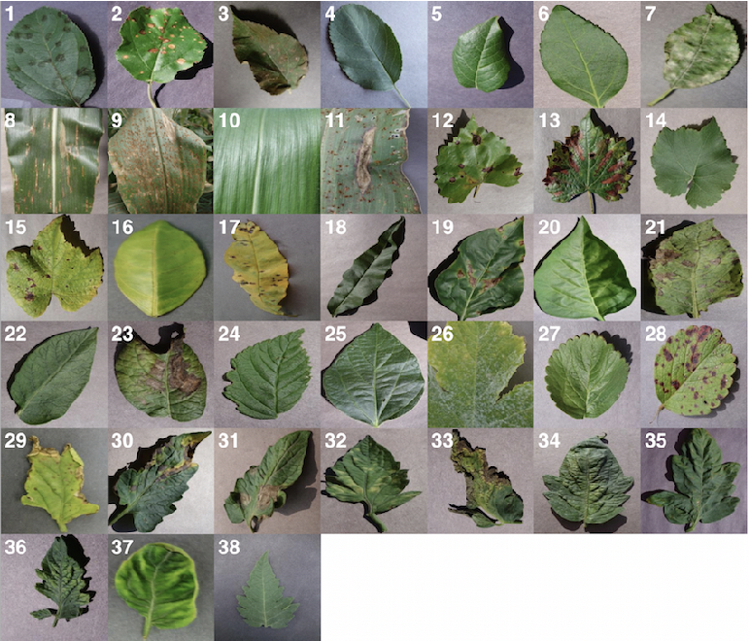
Sample images of various plant diseases from PlantVillage
Credits: Using Deep Learning for Image-Based Plant Disease Detection
Sharada Prasanna Mohanty1,2, David Hughes3,4,5, and Marcel Salathé1,2,6
https://arxiv.org/pdf/1604.03169.pdf

Slide 24
Discussion
What are the apparent characteristics of plant disease in the images?
How would you create an operational description to be used by a human? Like e.g. “look for whitish spots near the stem” etc.
How would you program the descriptions as executable feature extraction?
Notes:
Assignment: download sample image sets from PlantVillage; try to give a description of the disease symptoms

Slide 25
Deep Learning network
Structure: Convolutional Neural Network
Modeled on the mammal early vision system
Intermediate layers have receptive fields
Connections are replicated
Features are generated automatically

Slide 26
Typical convolutional neural network
Credit: Aphex34 (https://commons.wikimedia.org/wiki/File:Typical_cnn.png), https://creativecommons.org/licenses/by-sa/4.0/legalcode
Notes:
Explain convolution
Explain subsampling
Discuss why there are several levels

Slide 27

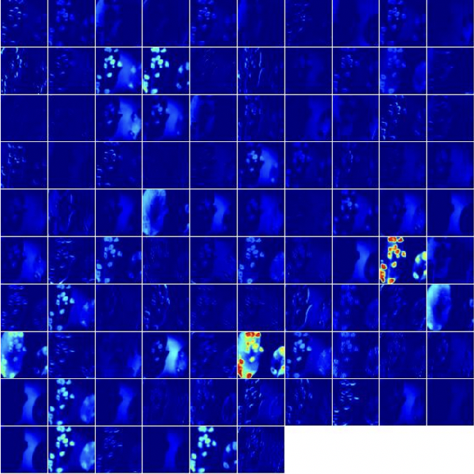
Activations in intermediate layer
Credits: Using Deep Learning for Image-Based Plant Disease Detection
Sharada Prasanna Mohanty1,2, David Hughes3,4,5, and Marcel Salathé1,2,6
https://arxiv.org/pdf/1604.03169.pdf
Notes:
Explain activation

Slide 28
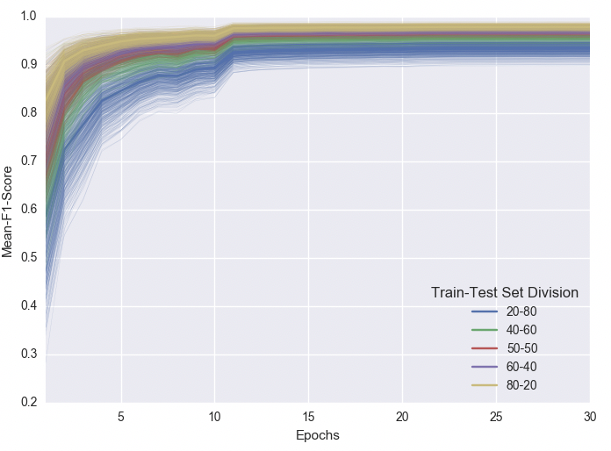
Progress of learning through 30 epochs
Credits: Using Deep Learning for Image-Based Plant Disease Detection
Sharada Prasanna Mohanty1,2, David Hughes3,4,5, and Marcel Salathé1,2,6
https://arxiv.org/pdf/1604.03169.pdf

Slide 29
Feature Transfer
An efficient trick for DL: domain-specific feature extraction shared between tasks
Train a DL network properly, then copy the input layers into another DL network
Most useful when:
we have a task with only a few data points
we have other tasks in the same domain with lots of available data

Slide 30
Transfer learning: re-use the trained feature maps
TASK 1
TASK 2
Credit: Aphex34 (https://commons.wikimedia.org/wiki/File:Typical_cnn.png), https://creativecommons.org/licenses/by-sa/4.0/legalcode

Slide 31
How does a DL network work?
We can visualize the activations in the network layers
This kind of analysis will help in improving the structure and operation of Deep Learning neural networks for specific tasks, especially if we deal with vision

Slide 32
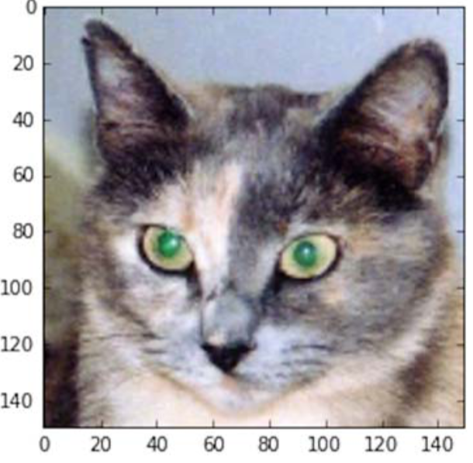
Illustration of image processing with DL
The original image
From: Deep Learning with Python, by Francois Chollet

Slide 33
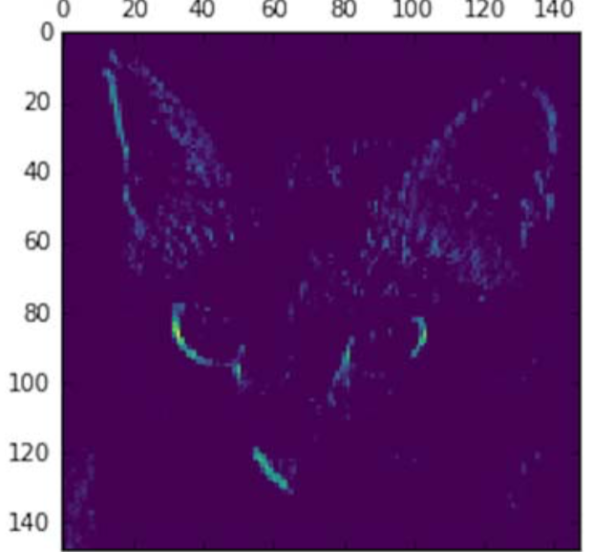
Illustration of image processing with DL
Fourth channel of the activation of the first layer on the test cat picture
Looks like an edge detector, similar to e.g. the Sobel operator in classical Computer Vision studies

Slide 34
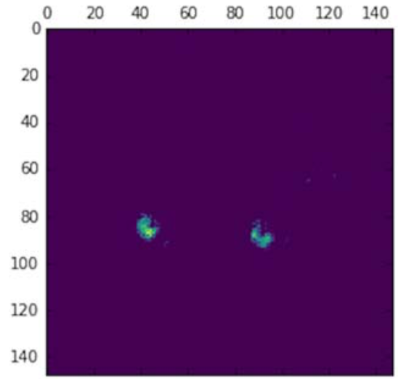
Illustration of image processing with DL
Fourth channel of the activation of the first layer on the test cat picture
This is a “green spot pair” detector, probably specializing to cats’ eyes…

Slide 35
Typical usage of Deep Learning
Well suited to processing of natural data (images, sounds, language, weather)
Can be used to create robust processors (autonomous cars, surveillance)
Enables the transfer of internal representations among AI systems
Many variants, designed for specific tasks (CDBN, DSN, TDSN, DPCN, …)

Slide 36

Some criticism
https://www.popularmechanics.com/technology/robots/a19445627/the-hilarious-and-terrifying-ways-algorithms-have-outsmarted-their-creators/
Notes:
AI stories are found in every field; encourage students to collect interesting and surprising ones.

Slide 37
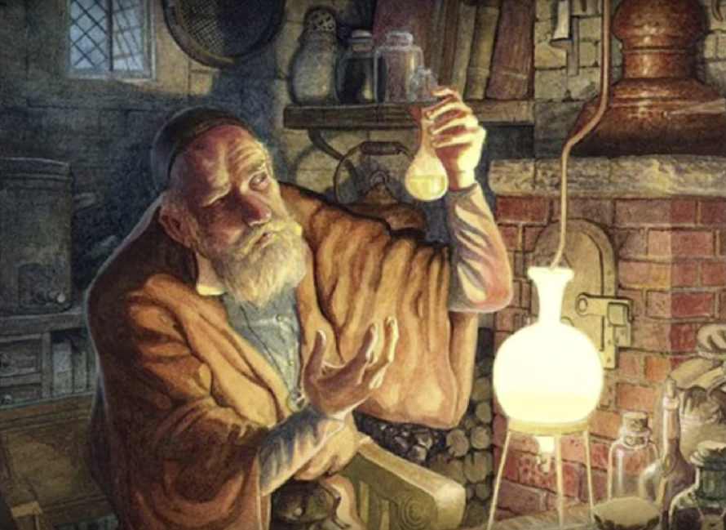
Try it and it (sort of) works. Good enough?
LeCun vs Rahimi: Has Machine Learning Become Alchemy?
The debate started with Google’s Ali Rahimi, winner of the the Test-of-Time award at the recent Conference on Neural Information Processing (NIPS). Rahimi put it bluntly in his NIPS presentation: “Machine learning has become alchemy.”
https://medium.com/@Synced/lecun-vs-rahimi-has-machine-learning-become-alchemy-21cb1557920d
Notes:
Google’s Ali Rahimi, winner of the the Test-of-Time award at the recent Conference on Neural Information Processing (NIPS)… put it bluntly in his NIPS presentation: “Machine learning has become alchemy.”
As AI gradually penetrates critical fields such as law and healthcare, the debate is bound to reignite.
Discuss how important is a theoretical foundation. Which point of view do you subscribe to?
it works, let’s use it!
without theory, we cannot tell if it gives correct results in a new field, so must check and cross-verify every time!

Slide 38
Other concerns with DL
Creating “adversarial examples” … team at MIT … published a study demonstrating how Google’s InceptionV3 image classifier could be duped into thinking that a 3-D-printed turtle was a rifle.
It is now possible in “black box” conditions
https://www.wired.com/story/researcher-fooled-a-google-ai-into-thinking-a-rifle-was-a-helicopter/
Notes:
Discuss implications for critical usage (security, military etc.)
How to manipulate an AI system?
How would “social engineering” look like in a society with a mixture of humans and AI?

Slide 39
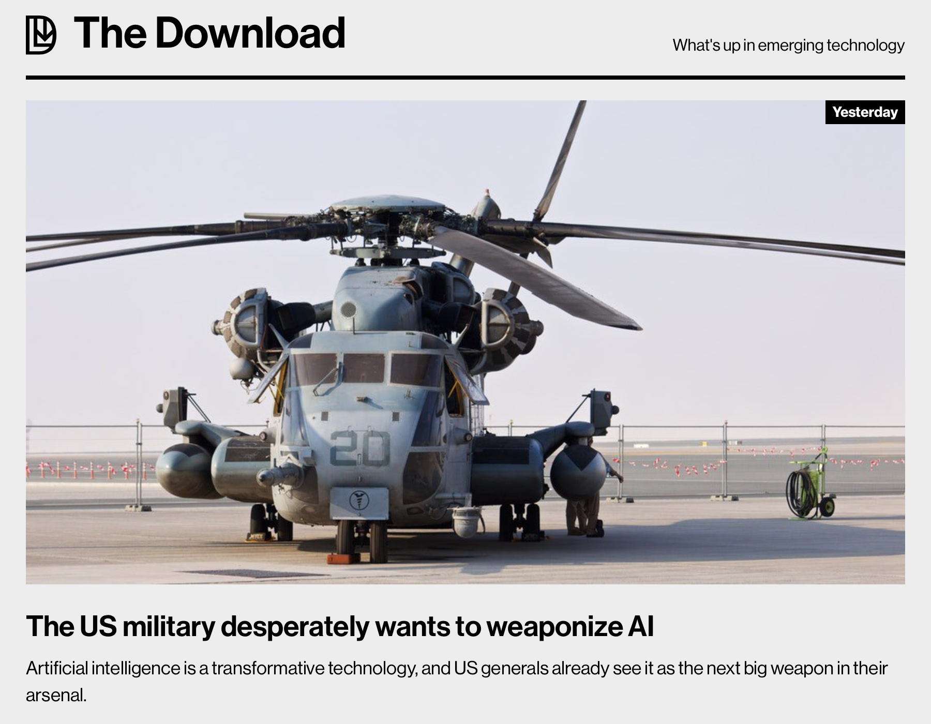
How will it play out in a military scenario?…
https://www.technologyreview.com/the-download/610842/the-us-military-desperately-wants-to-weaponize-ai/
Notes:
Engage students in debate about:
Is defense an appropriate field for deploying AI?
What safeguards do you want to see?
What about potential adversaries with less scruples?
What is a possible scenario for offense / defense?

Slide 40
Discussion
Search for existing success stories with DL
Search for potential new applications:
What makes a problem promising for DL?
Data with structure?
Large sample sets?
Search now in the context of IoT:
Sensors?
Images?
Notes:
Start from Google, Amazon, IBM, the big players.
Then take a look at startups, niche companies.
Essay: your view of Deep Learning as a tool for understanding data

Slide 41
Summary of the lecture
We have looked into the use and characteristics of the Deep Learning (DL) AI method.
We have found out about its background, motivations for its development, and some of the useful techniques with DL.
We have also reviewed some of the criticism: how important is it to have clear scientific foundations for such a successful tool?

